Slide 1
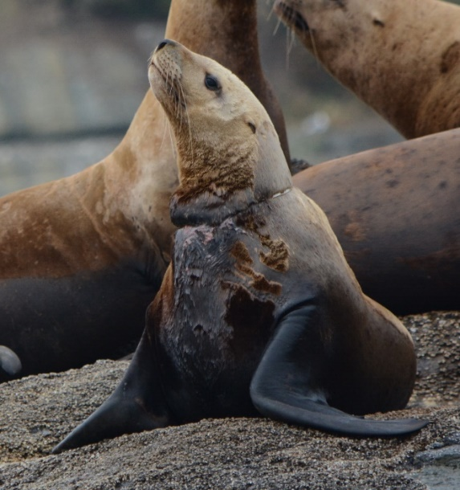
Sea lion entanglement in NW Washington
MRC Meeting Jan 11, 2021
Liz Allyn
Makah Tribe
liz.allyn@makah.com

Slide 2



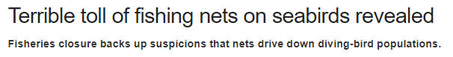
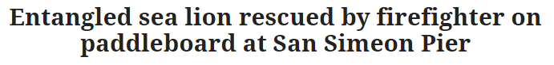
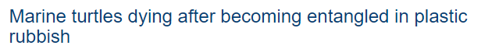
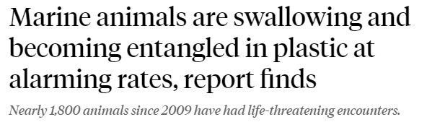
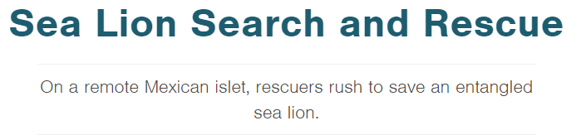
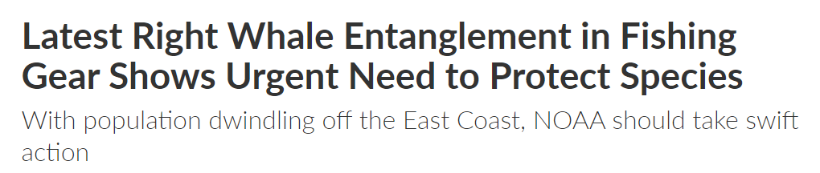

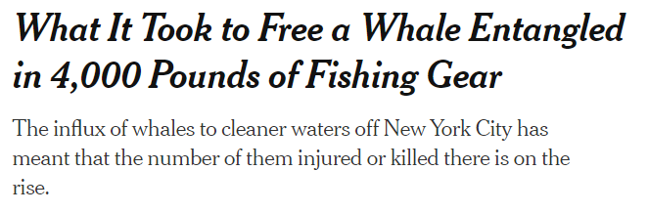

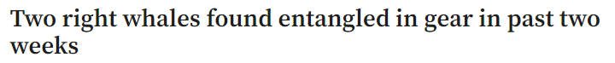
Notes:
As our coastlines become more populated entanglement is becoming more visible and it’s becoming more obvious just how many species are impacted, and the many ways that entanglement can impact health and survival for the affected animals. In our area we see entangled sea lions fairly regularly so we wanted to answer a few questions about how frequently this might be occurring and what factors might exacerbate entanglement risk in our area.

Slide 3
Research Questions
What are the entanglement rates for Steller and California sea lions on the NW coast of WA?
What are the most common entangling materials?
Does entanglement risk vary by sea lion species, sex or age?
Are there annual or seasonal trends in entanglement occurrence?
Are entanglements impacting Steller and California sea lion populations?

Slide 4
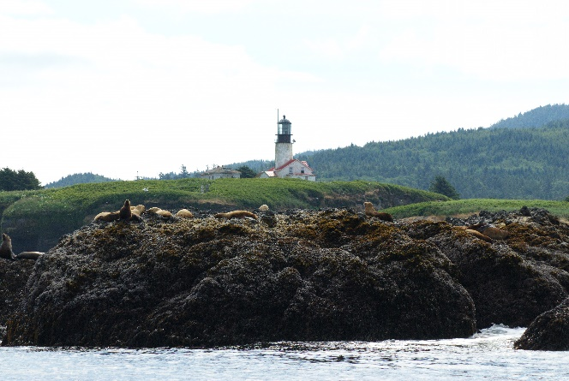
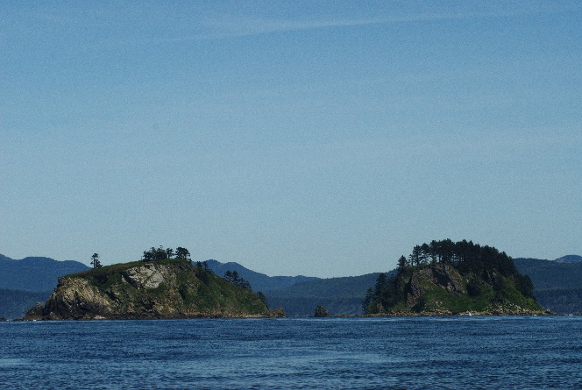
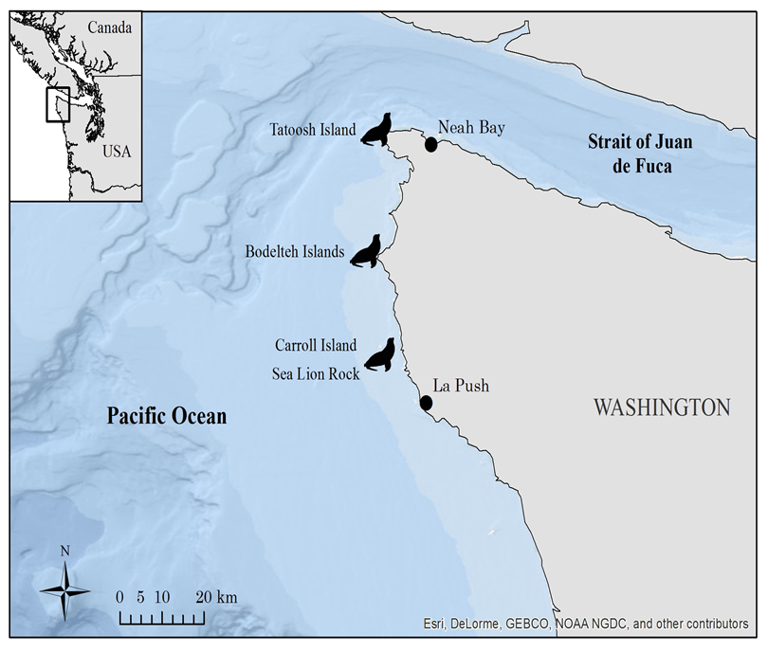
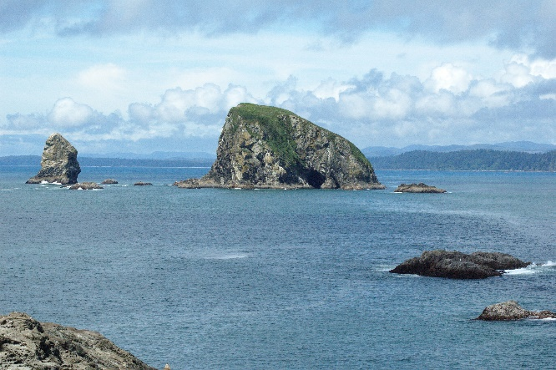

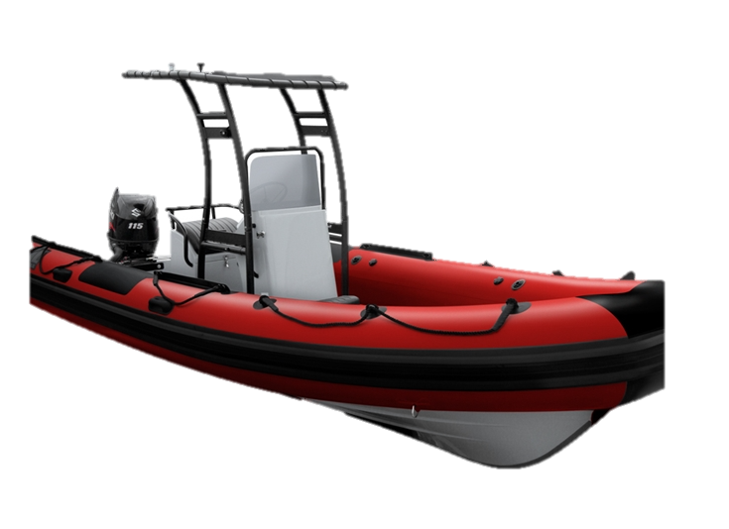
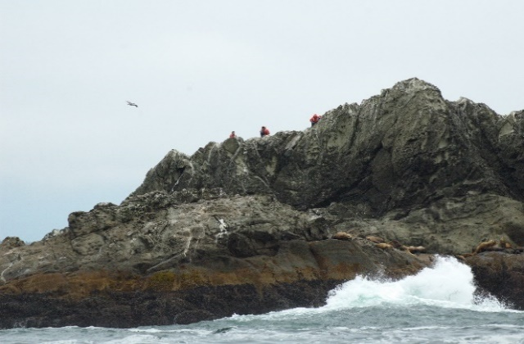
Data was collected during small boat surveys of the Makah U&A
R/V Kawad

Slide 5
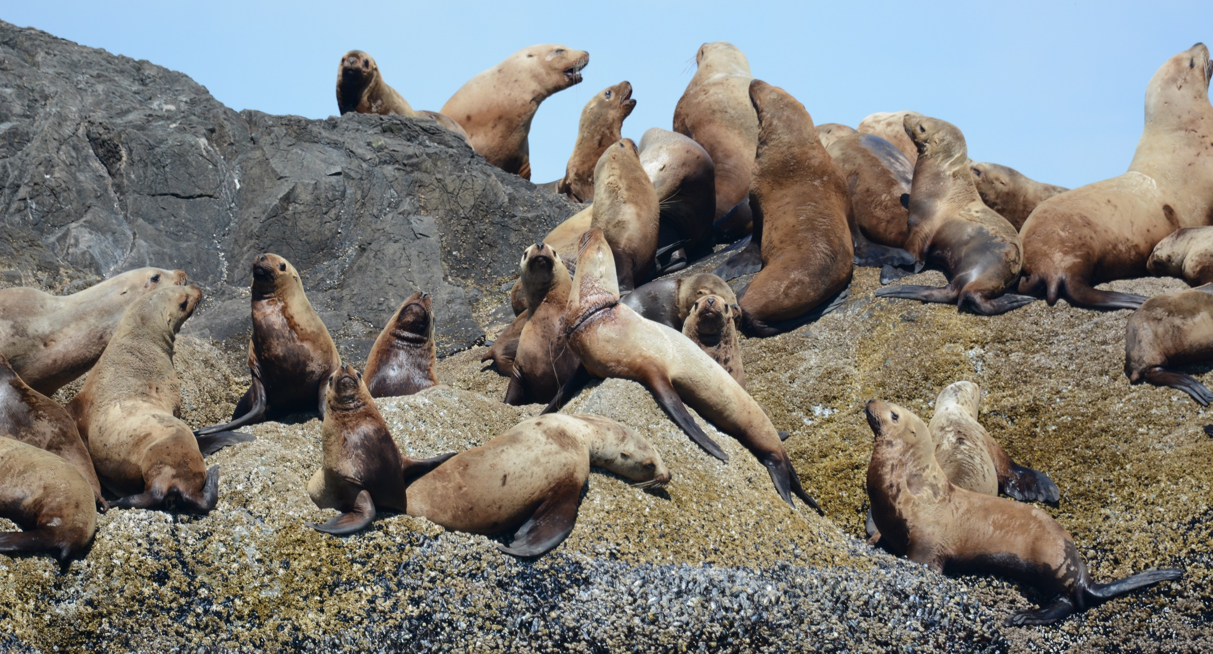
Step 1: Total Count for both California and Steller sea lions

Slide 6
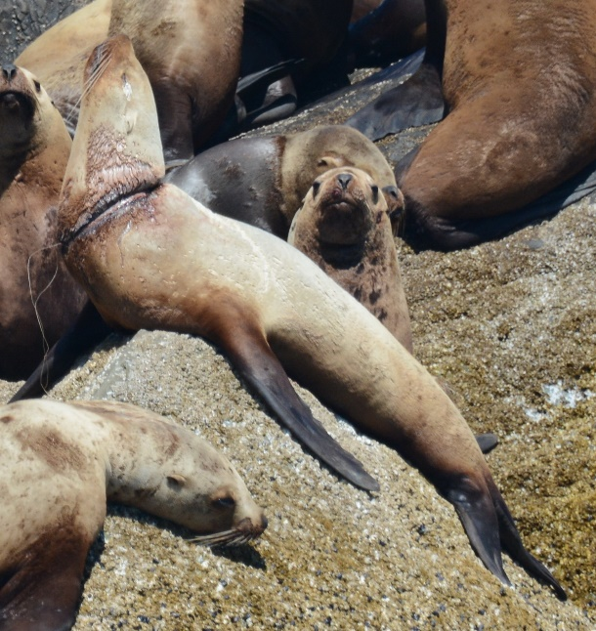
Step 2: Find Entanglements

Slide 7
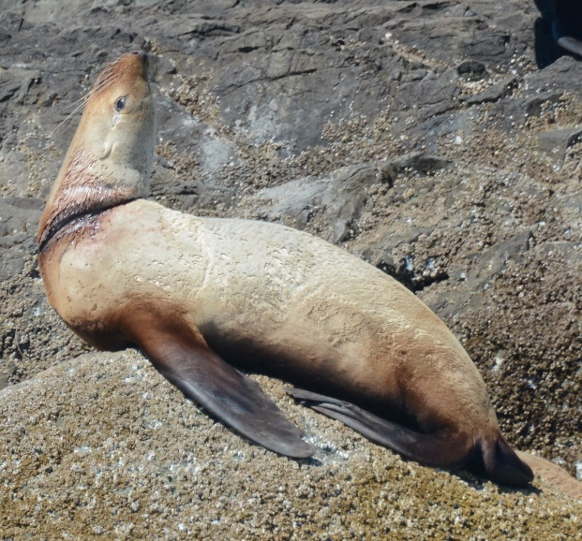
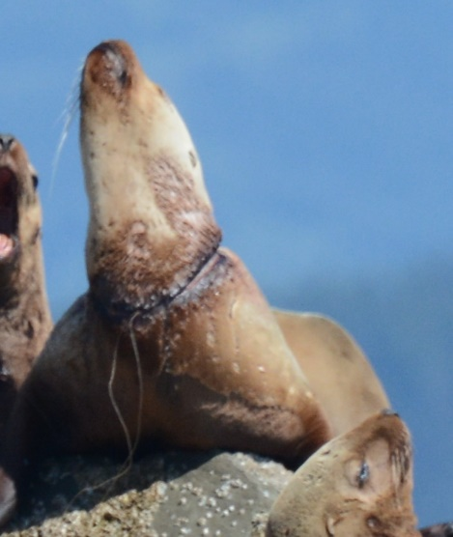
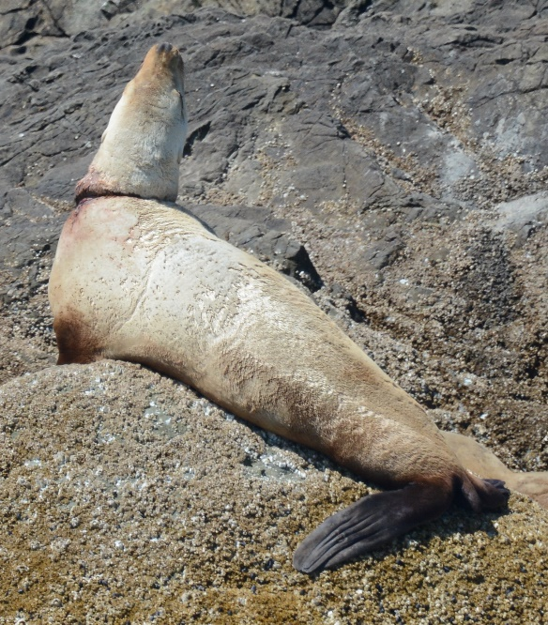
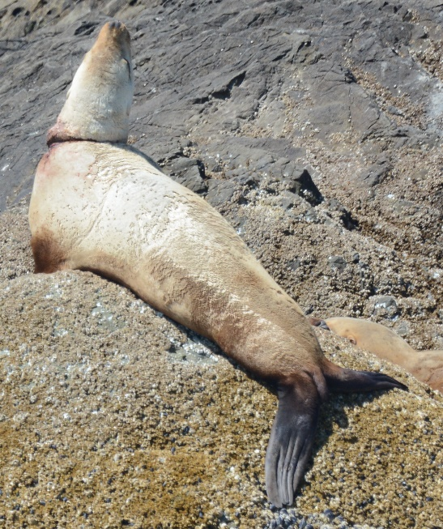
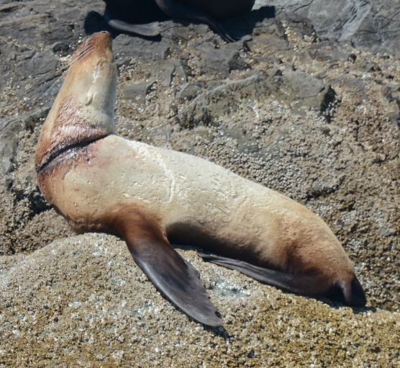
Step 3: Count and Document

Slide 8
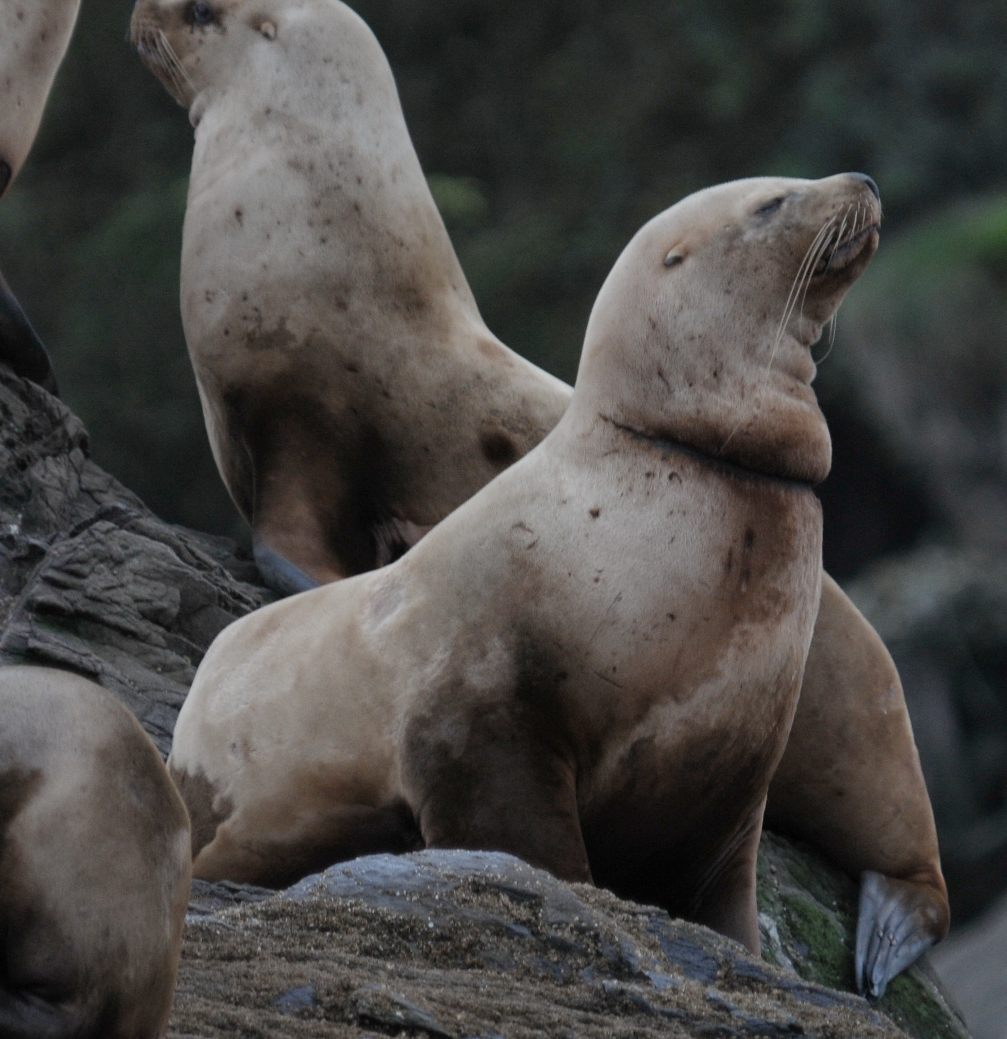
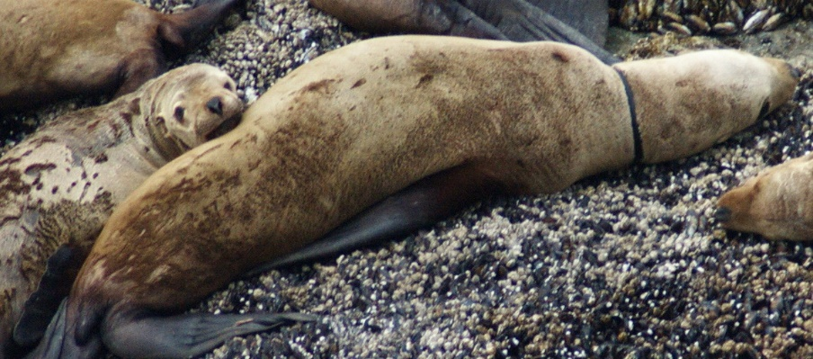
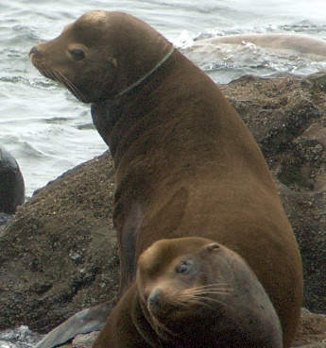
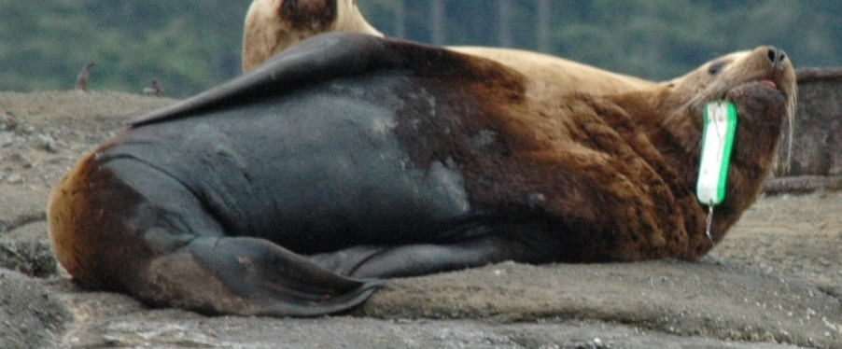
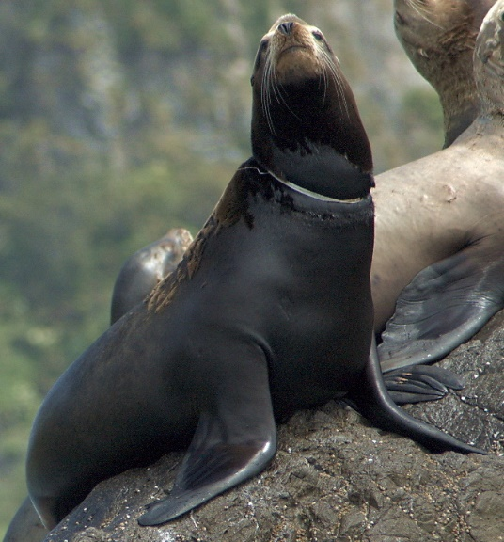
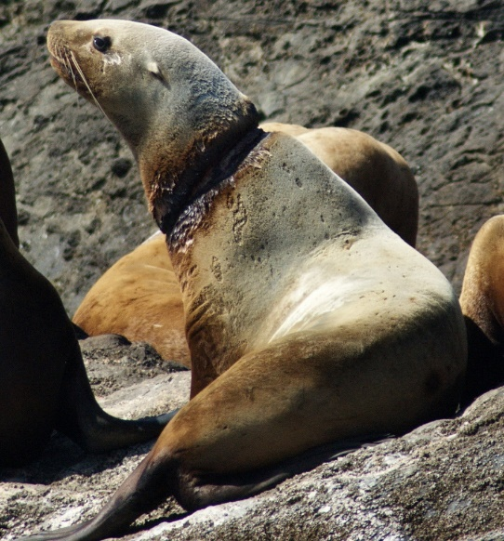
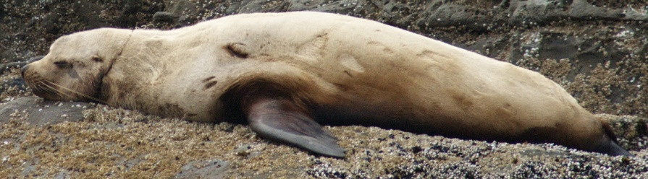
Photo analysis determined the species, sex, and age of the individual and the material type
Steller
Rubber Band
Steller
Scar
California
Rope
Steller
Flasher
California
Packing Band
Steller
Monofilament
Steller
Unknown

Slide 9
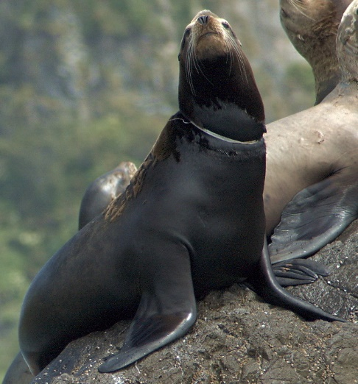

Both species experienced high rates of entanglement
California: 2.13%
Steller: 0.41%

Slide 10
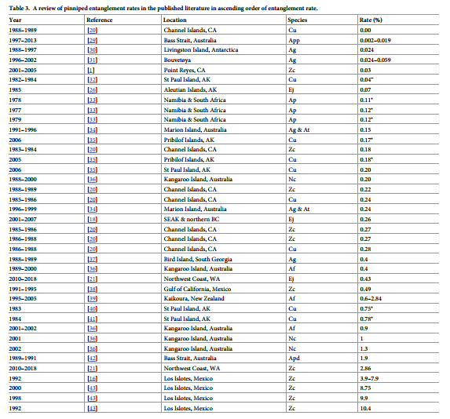
Low
Highest Steller rate in world
Highest California rate in US
High

Slide 11
Both species have increased their use of the study area by ~8% annually
Steller: 7.9% avg
California: 7.8% avg

Slide 12
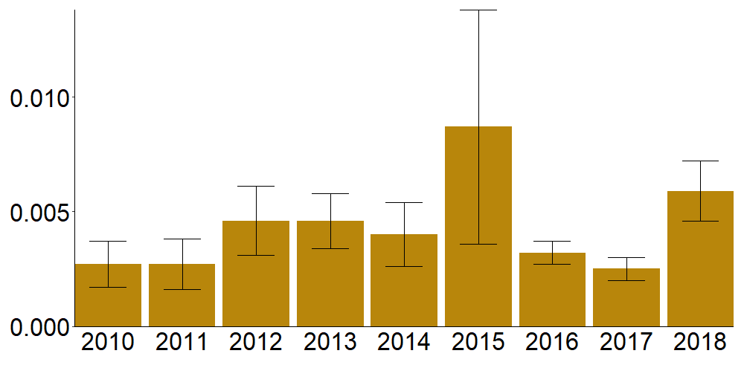
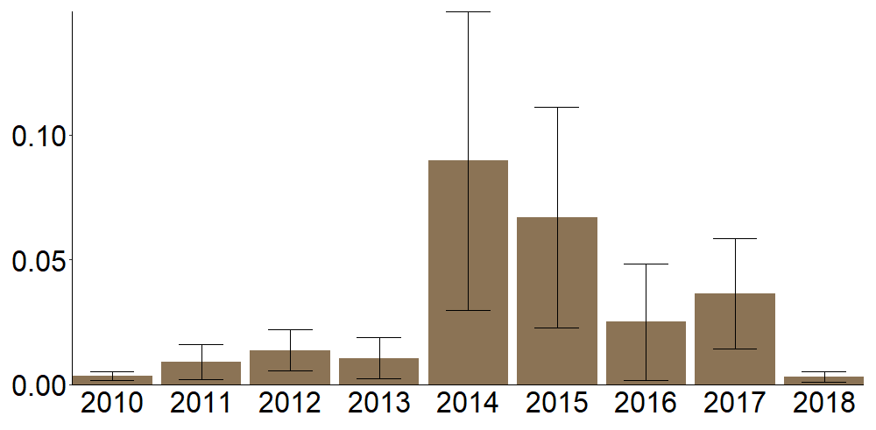
Consistent annual entanglement rates over study period
Elevated entanglement rates in 2014-2015
El Niño event
“The Blob” 2014 - 2016
Average Entanglement Rate
Year

Slide 13
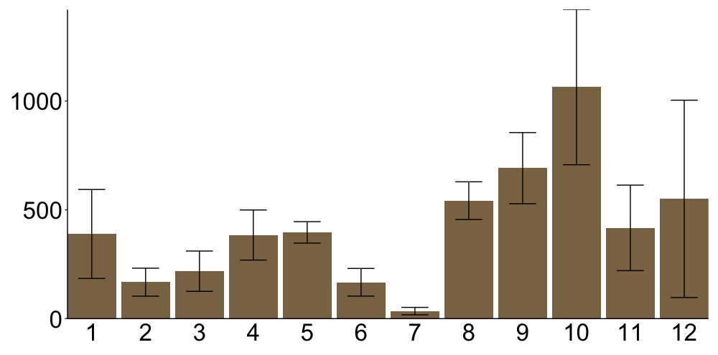
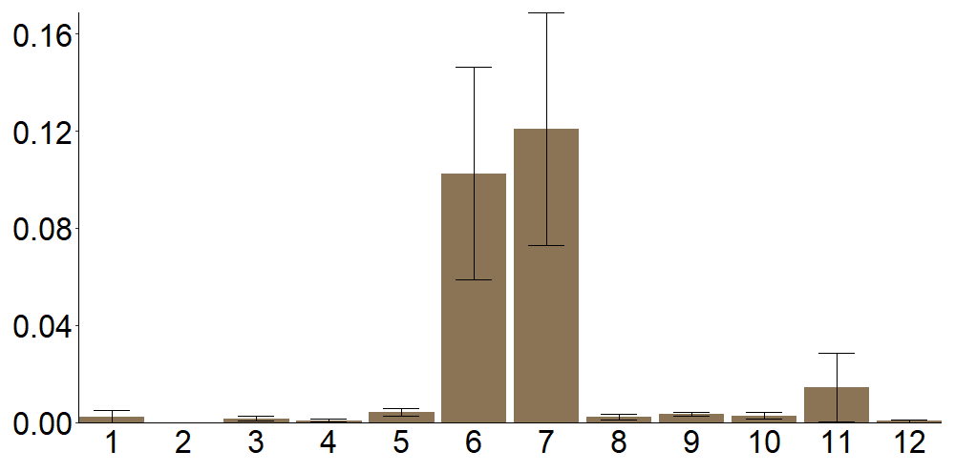
Californias showed high entanglement rates and low overall counts in the summer months Entangled animals don’t migrate to breed?
Average Count
Average Entanglement Rate
Month

Slide 14
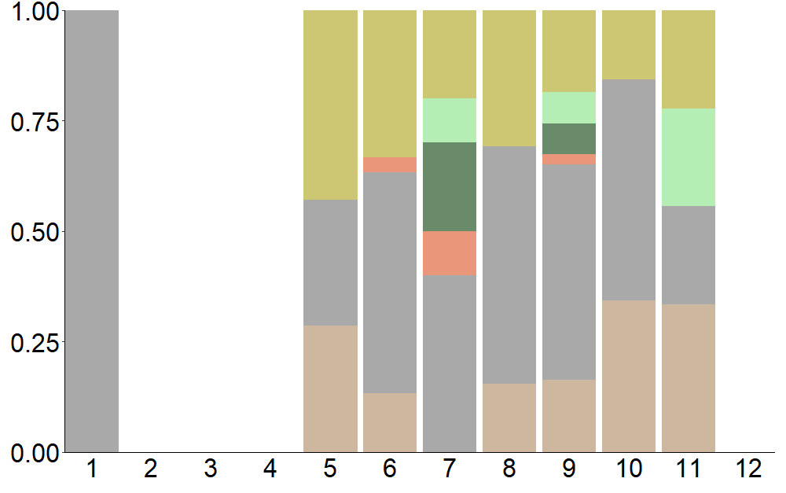
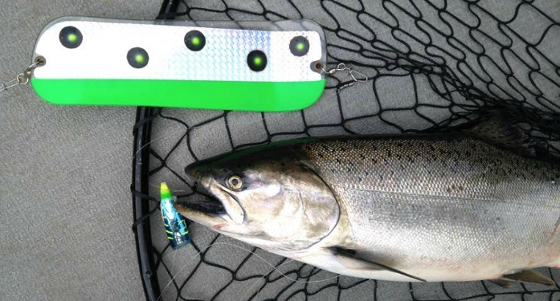
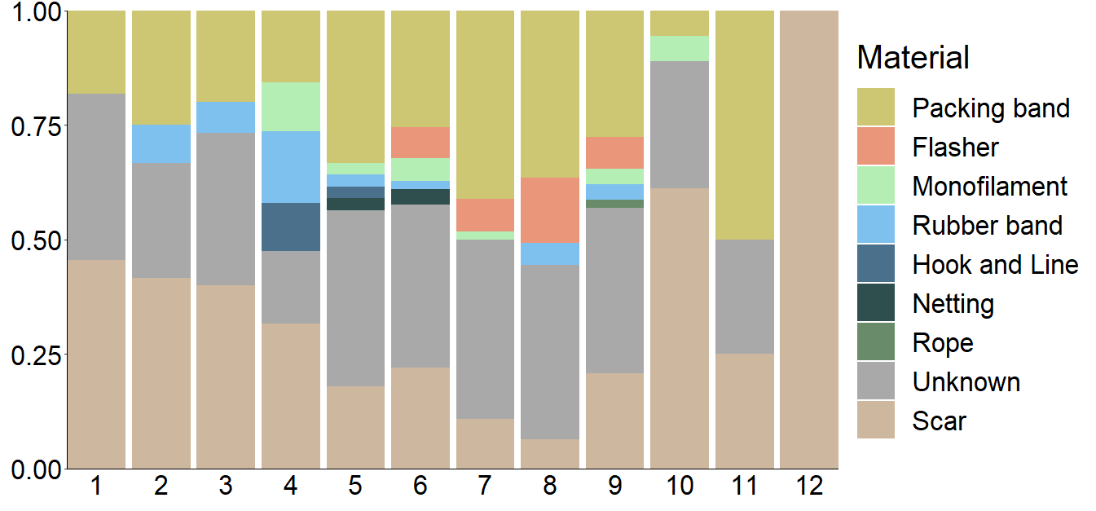
Salmon Flashers only seen during summer season
Proportion of Entanglements
Month

Slide 15
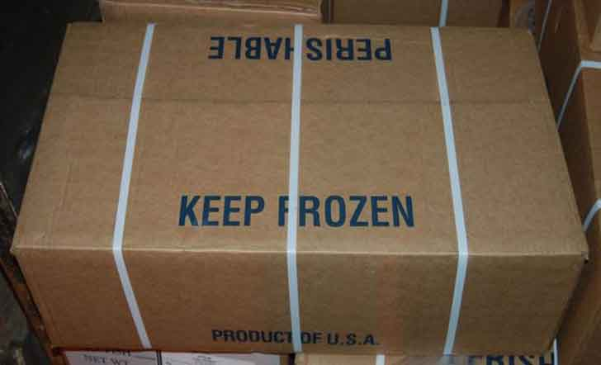
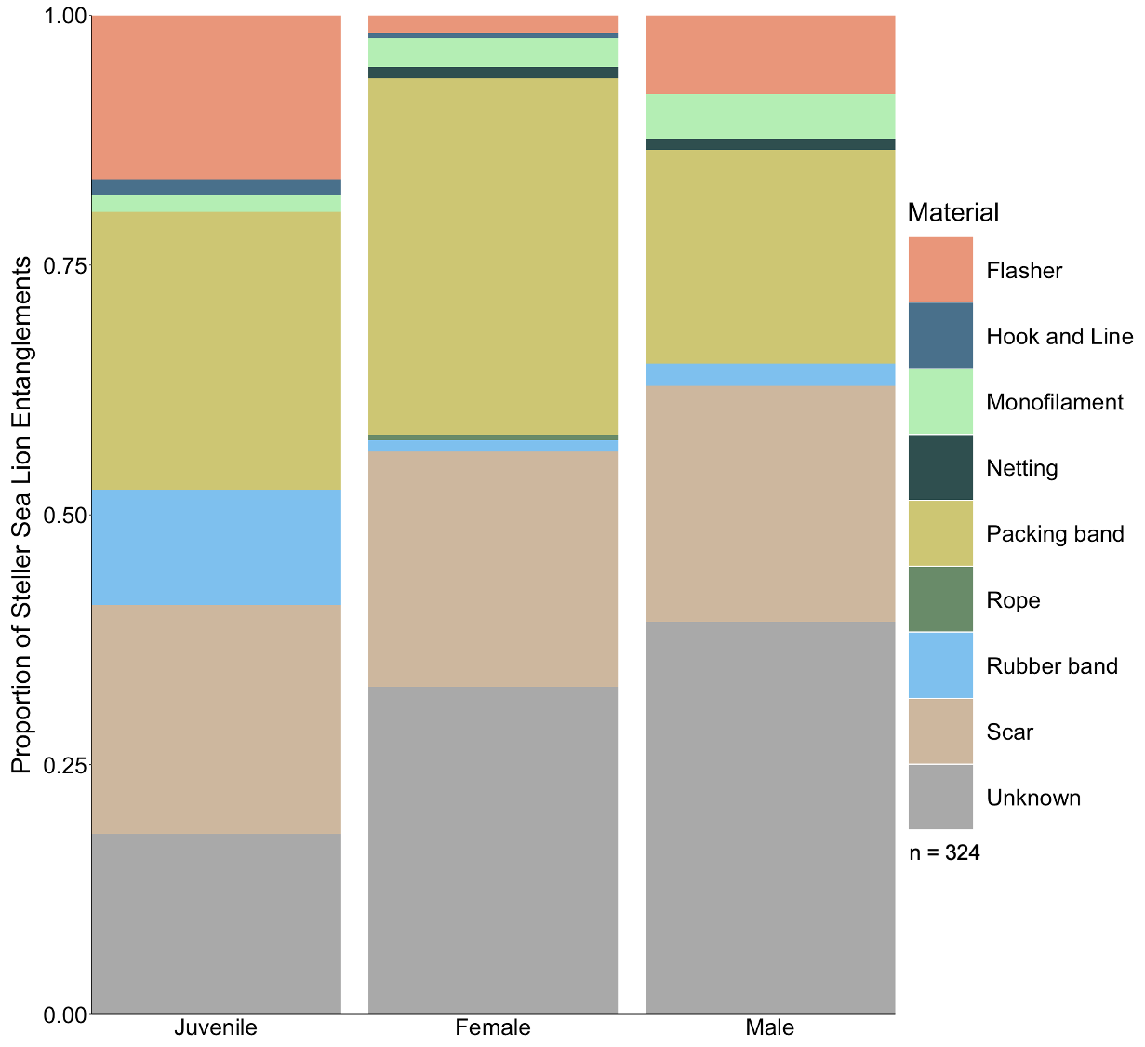
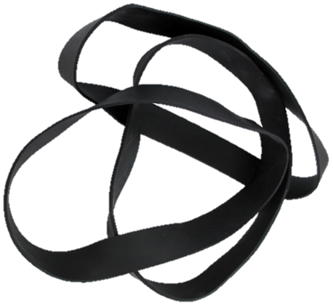
More unidentifiable on males – seasonal growth causes embedding
Most identifiable entanglements for both species were packing bands
Juveniles entangle in flashers – risky behavior
Juveniles entangle in rubber bands – small enough neck

Slide 16
The availability of packing bands in the environment corresponds with entanglement

Slide 17
Animals might shed entanglements more than previously assumed
Rate of entanglement in stranding record similar to live rates from this study
No animals stranded dead with a packing band entanglement in WA/OR
Are animals shedding entangling materials and surviving entanglement more frequently than we realize?
Some evidence in published studies and field observations that this could be true
Need to follow survival of individuals to be sure

Slide 18
Thank You!
Questions?
Liz Allyn
liz.allyn@makah.com

